Slide 1


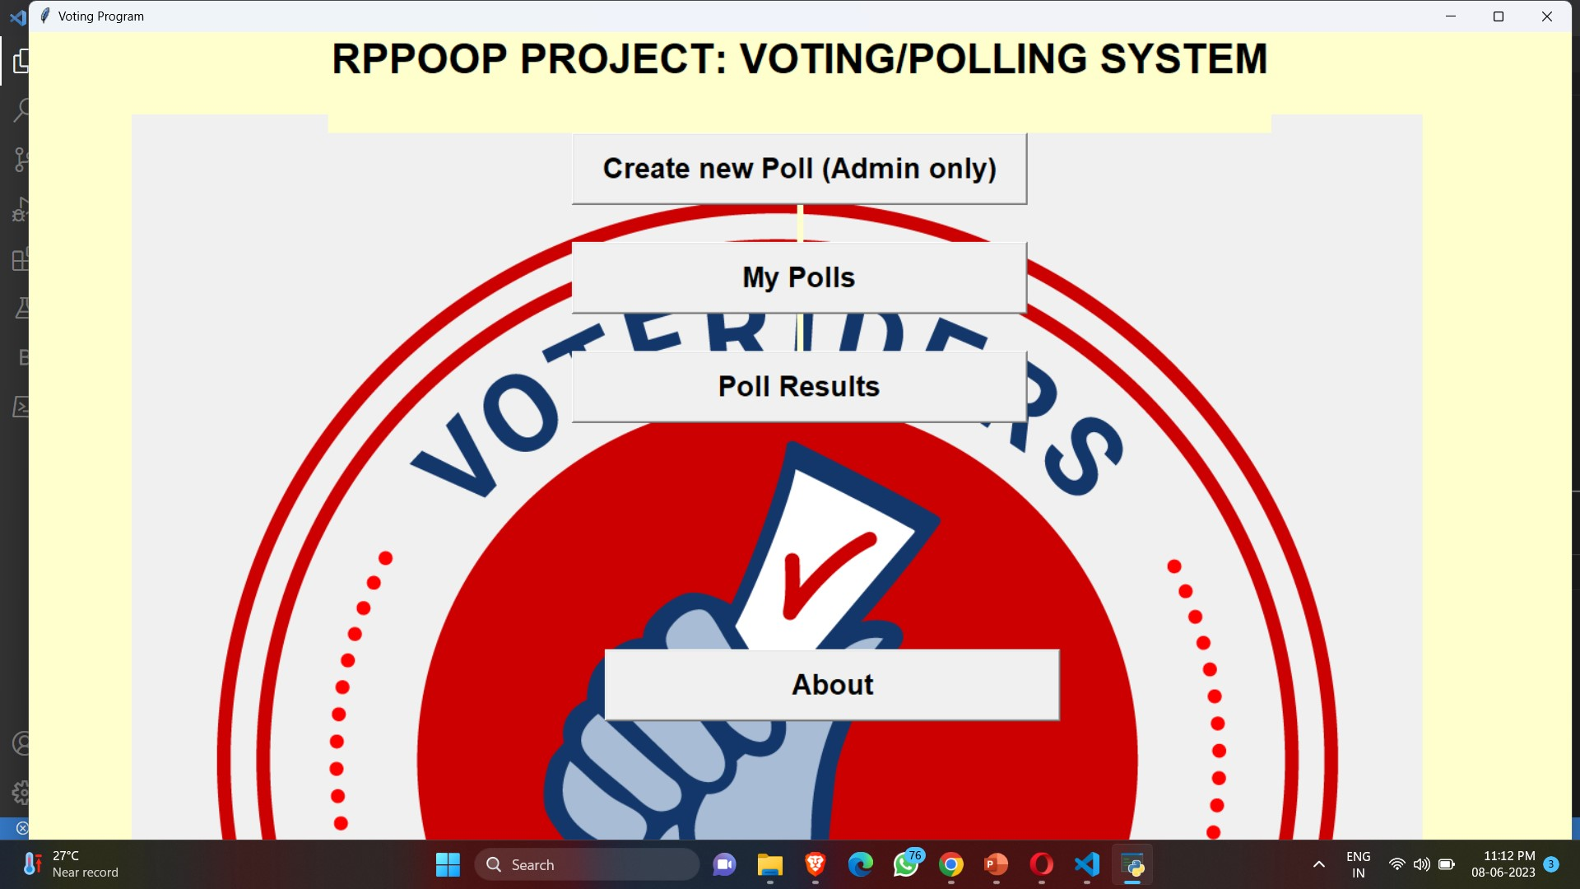
POLLING/VOTING SYSTEM
RPPOOPS PROJECT
Team Members
112103116 RITIKA KHER
112103125 AVANTIKA SAWALE

Slide 2



FEATURES
It allows voters and election observers to verify that votes have been recorded, tallied and declared correctly.
You can vote while sitting anywhere.(at home using your mobile , PC , etc ) without wasting time to go to a particular place to vote.

Slide 3

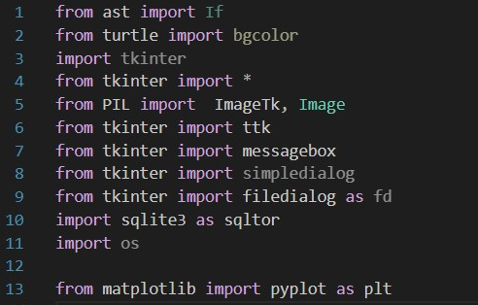
Language Used
Python

Slide 4
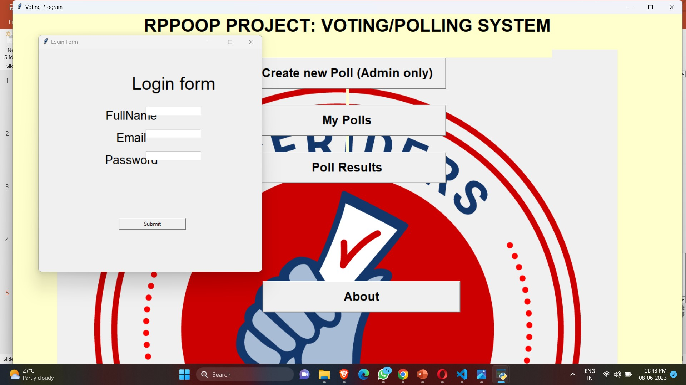
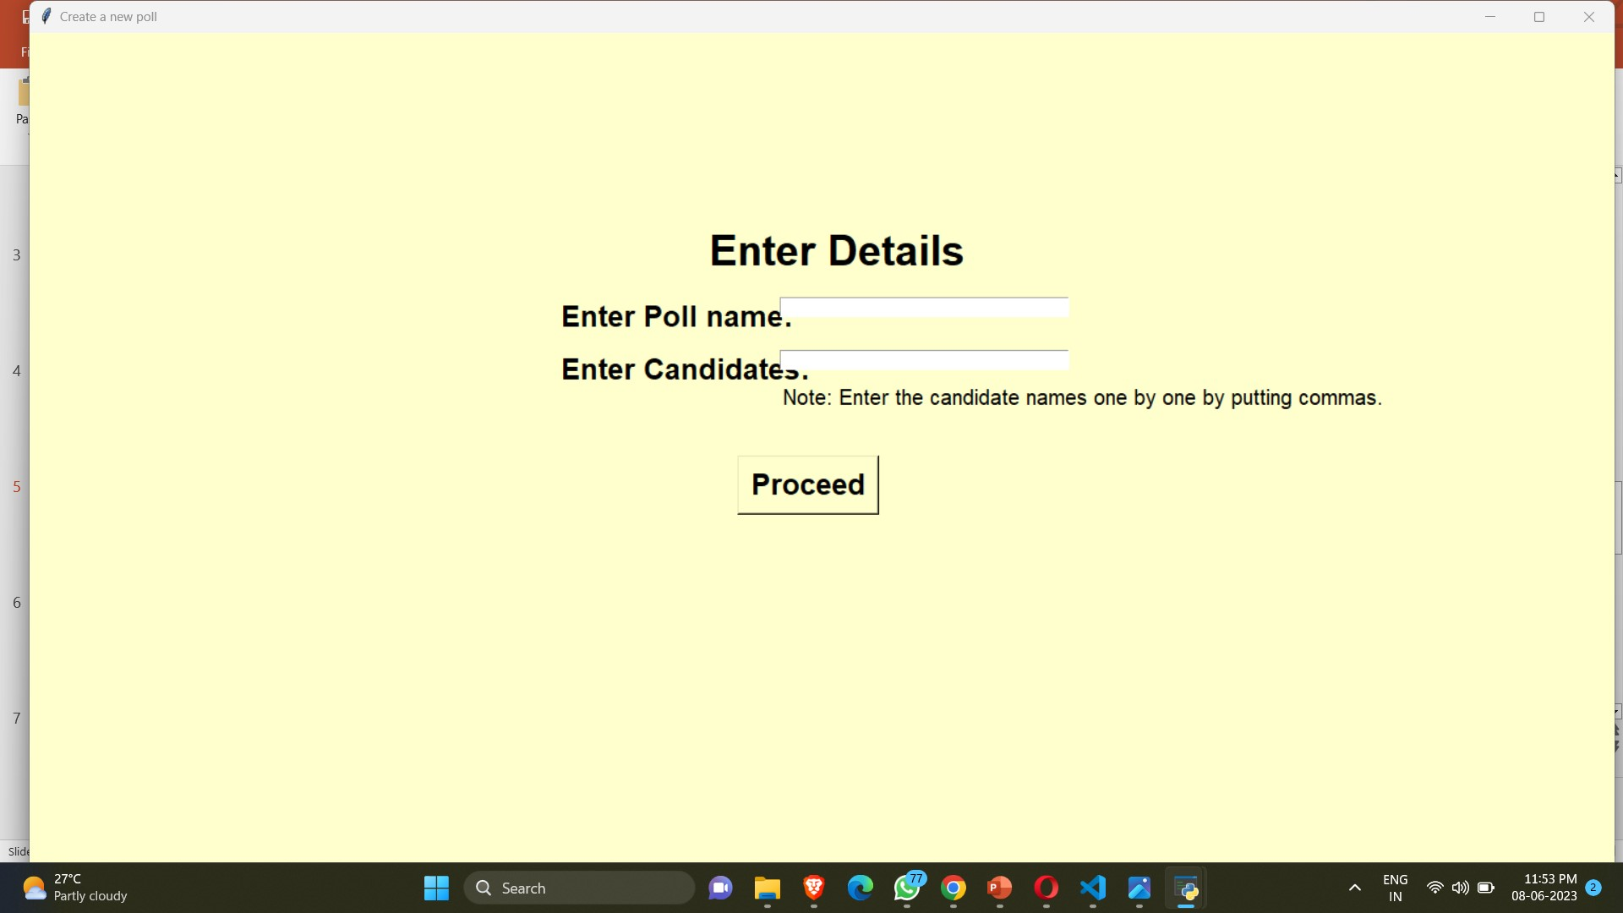
ADMIN
Name
Email
Password
Create new poll

Slide 5
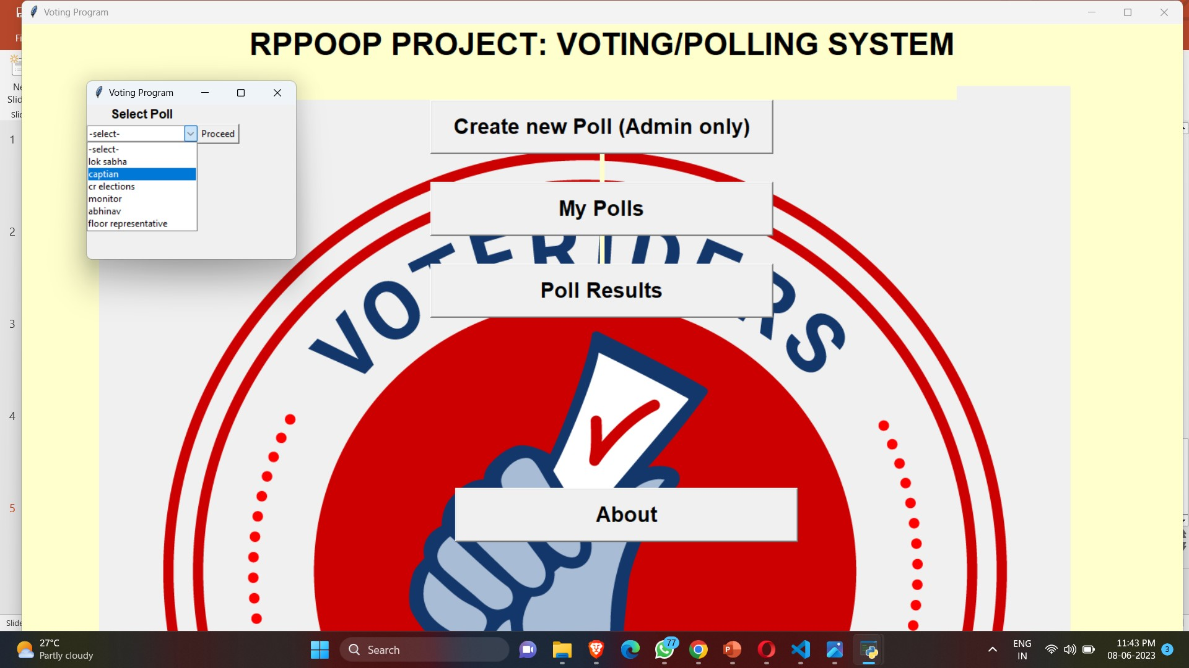
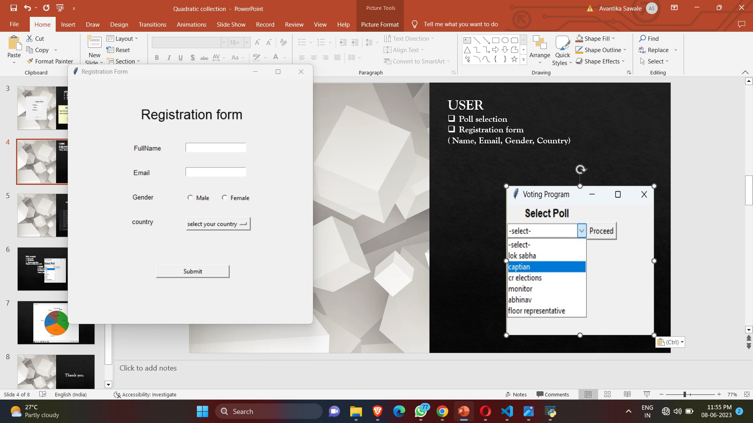
USER
Poll selection
Registration form
( Name, Email, Gender, Country)

Slide 6
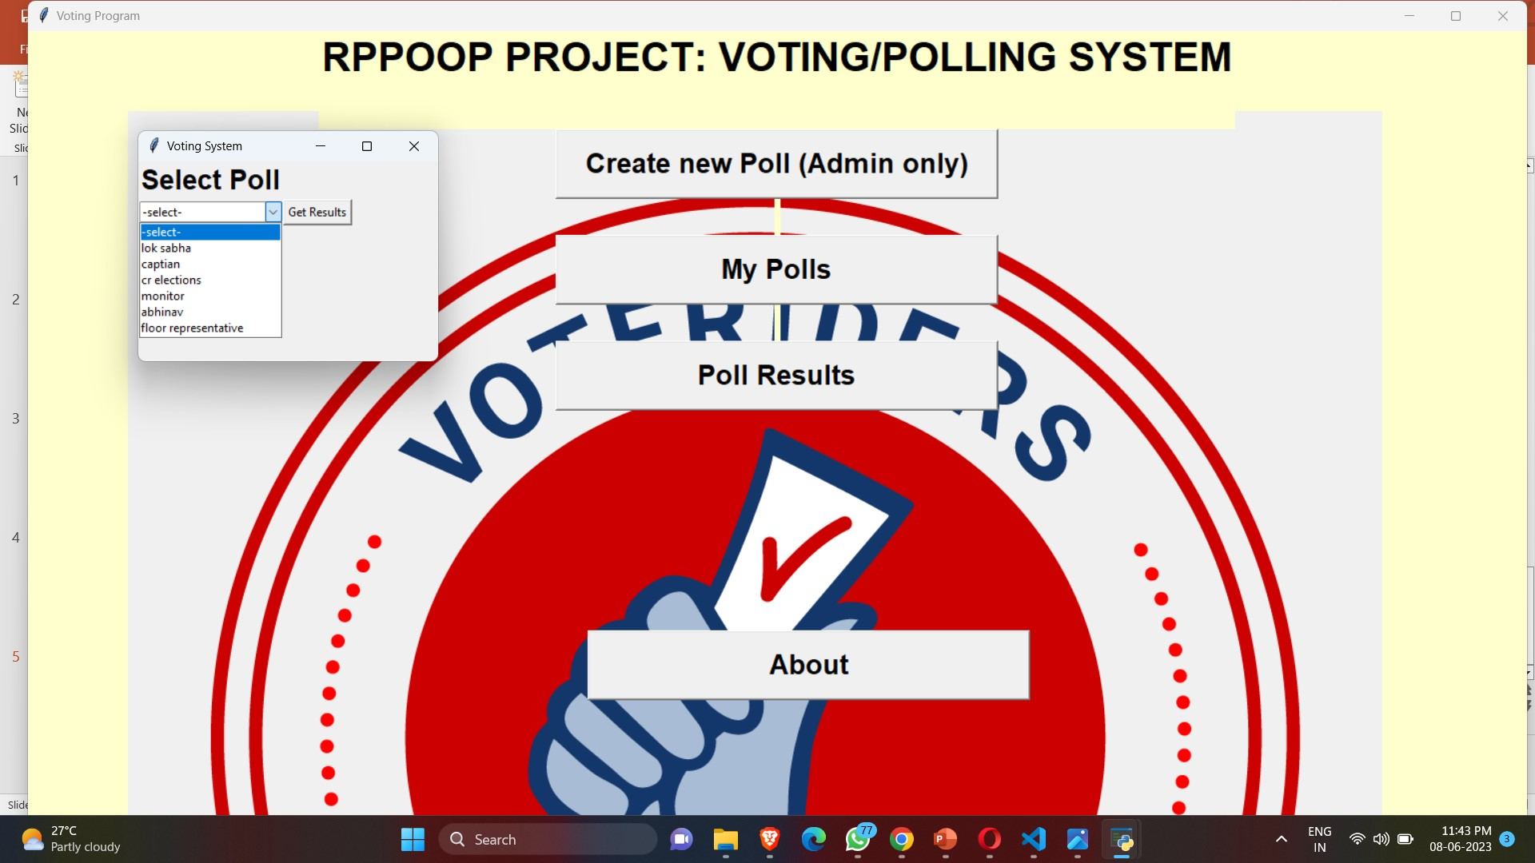
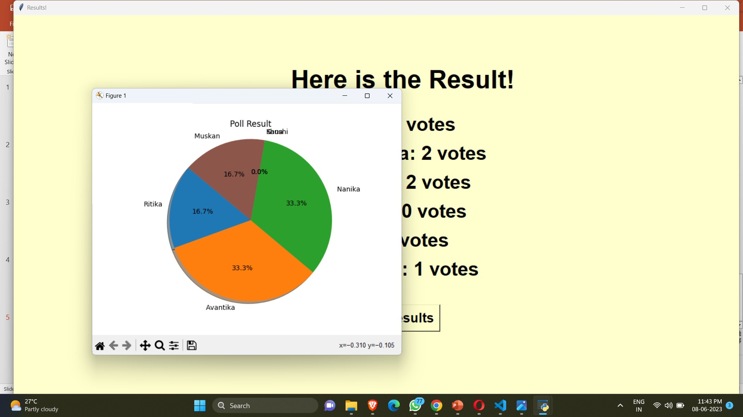
Poll results
Select poll
Get Result
Project result plot
(Subplot configuration tool)

Slide 7
Thank you

